Slide 1

IOT ANALYTICS
Energy Consumption Analysis
3.8.21

Slide 2

INTRODUCTION
HOW WE DID LAST YEAR
We have been tasked by the lead attorney of a law firm with helping to analyze a sizeable data archive to prove or disprove their client’s assertion or residential occupation. Although we don’t know the full scope of the client’s case, the client claims to have not been occupying a specific residence at the time of an undisclosed event having occurred during the Summer of 2008.
Our team analyzed three full years of archived data from 2007 - 2010 to gain insight on usage trends and anomalies.
Additionally, we built predictive models to forecast future energy consumption, accounting for seasonality and stationarity, to better recommend solutions for energy optimization at the behest of our client.

Slide 3
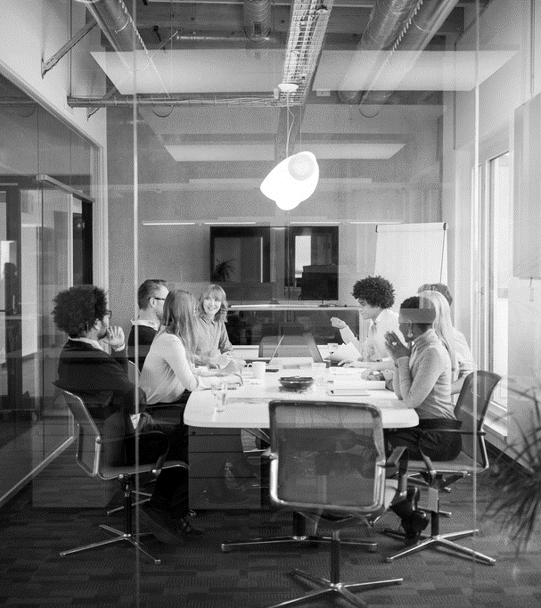
Agenda
SMART HOME DOMAINS, SUBMETERS AND HOUSEHOLD POWER CONSUMPTION
TIME SERIES ANALYSIS
LINEAR REGRESSION FORECASTING
UNDERSTANDING TRENDS
PREDICTIONS AND CORRELATIONS
RECOMMENDATIONS
FINAL THOUGHTS

Slide 4
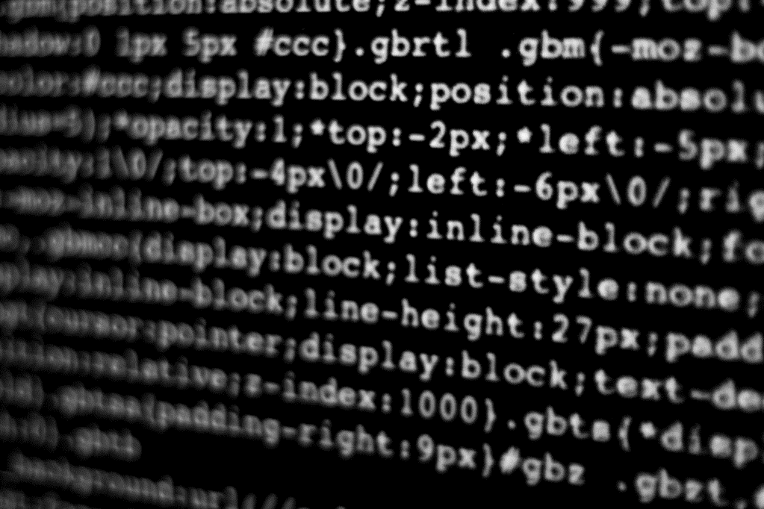
SMART HOME DOMAINS, SUBMETERS AND HOUSEHOLD POWER CONSUMPTION
Let’s Dive In

Slide 5
Data overview
KITCHEN
Total energy used (1,819,989 Watts)
LAUNDRY
Total energy used (2,108,410 Watts)
WATER HEATER & A/C
Total energy used (9,758,843 Watts)
Average Use: 6.21 Watts per minute
Energy Use Range: 0-32 Watts
Average Use: 1.34 Watts per minute
Energy Usage Range: 0-78 Watts
Average Use: 1.16 Watts per minute
Energy Usage Range: 0-82 Watts
Energy consumption is based on watts/hr of activity
As you can see, the water heater and A/C unit were the largest consumers of energy, with the tightest range of wattage usage per minute.
Conversely, the kitchen utilized the least amount of overall energy consumption, with the widest range of wattage used per minute.

Slide 6
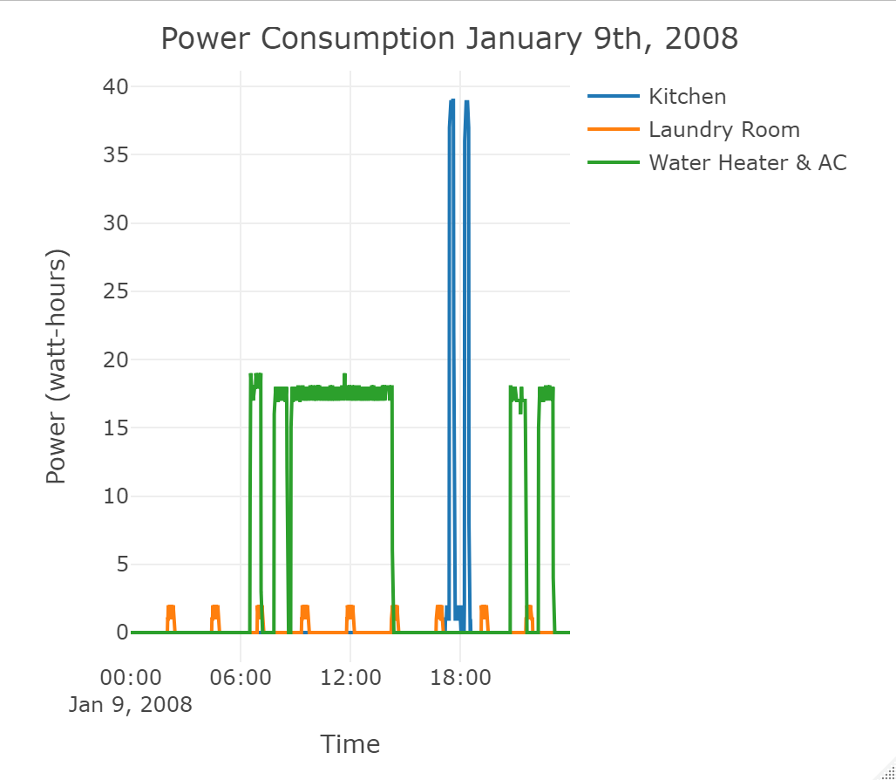
January 9, 2008
Energy use in a typical day
This visualization depicts patterns of energy usage unique to the appliances the submeters track. Here we can see the Laundry Room remains relatively constant in its consumption; presumably owing to the refrigerator constant and consistent energy usage. Conversely, the Kitchen seems to experience spikes in energy consumption commensurate with food preparation around mealtimes. Again, the Water Heater & A/C tend to consume energy when the occupant is showering and present in the home.

Slide 7

TIME SERIES ANALYSIS

Slide 8
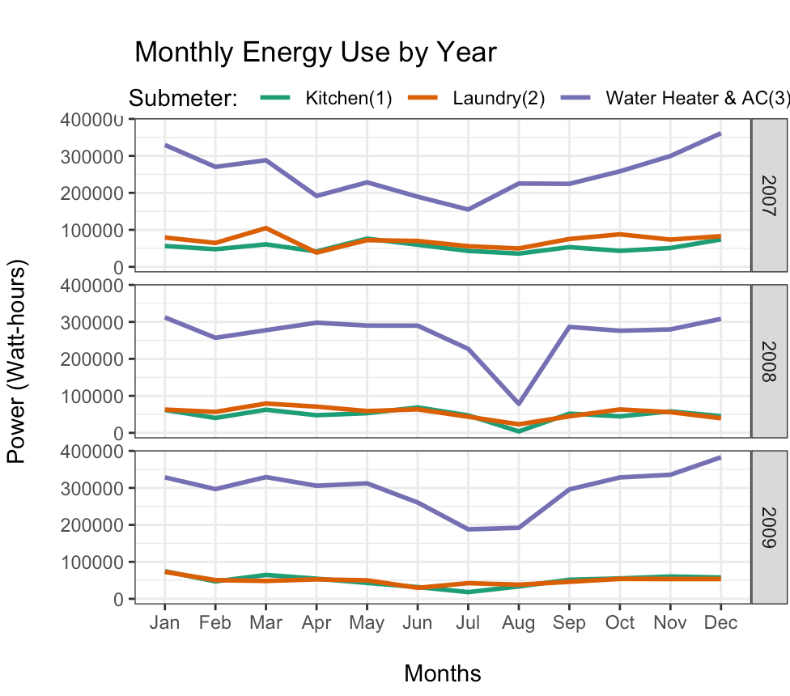
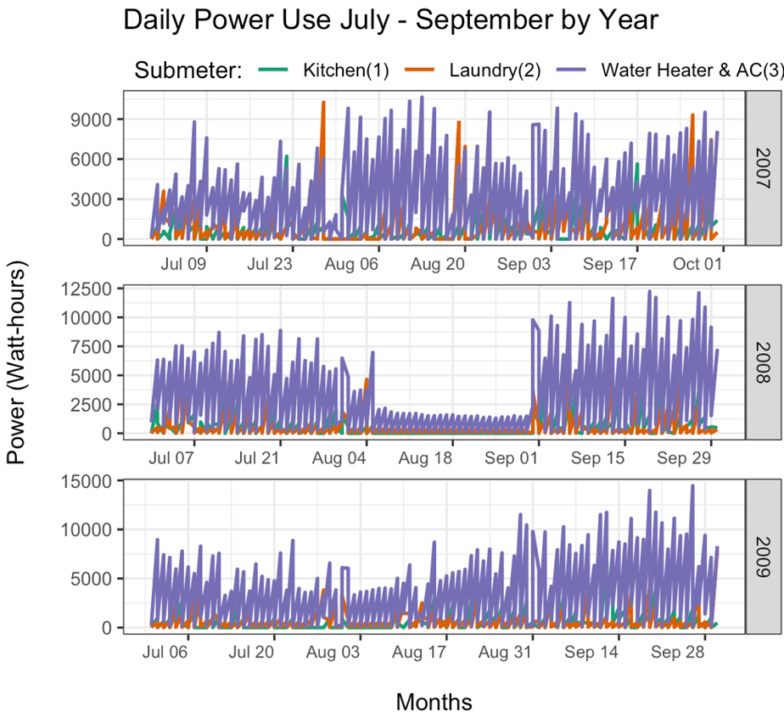
Time series analysis

Slide 9
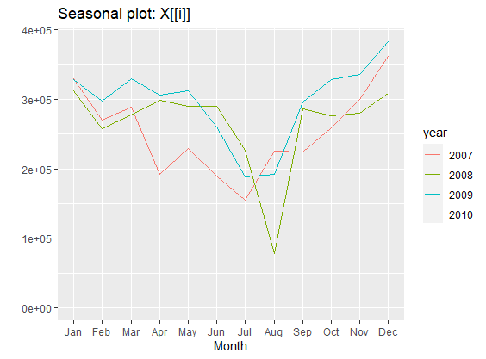
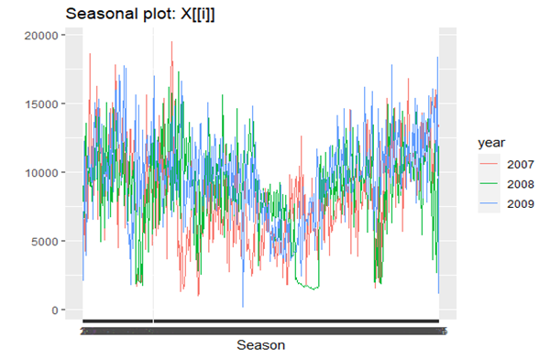
Time series analysis

Slide 10
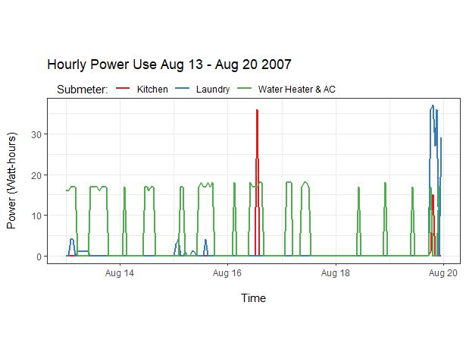
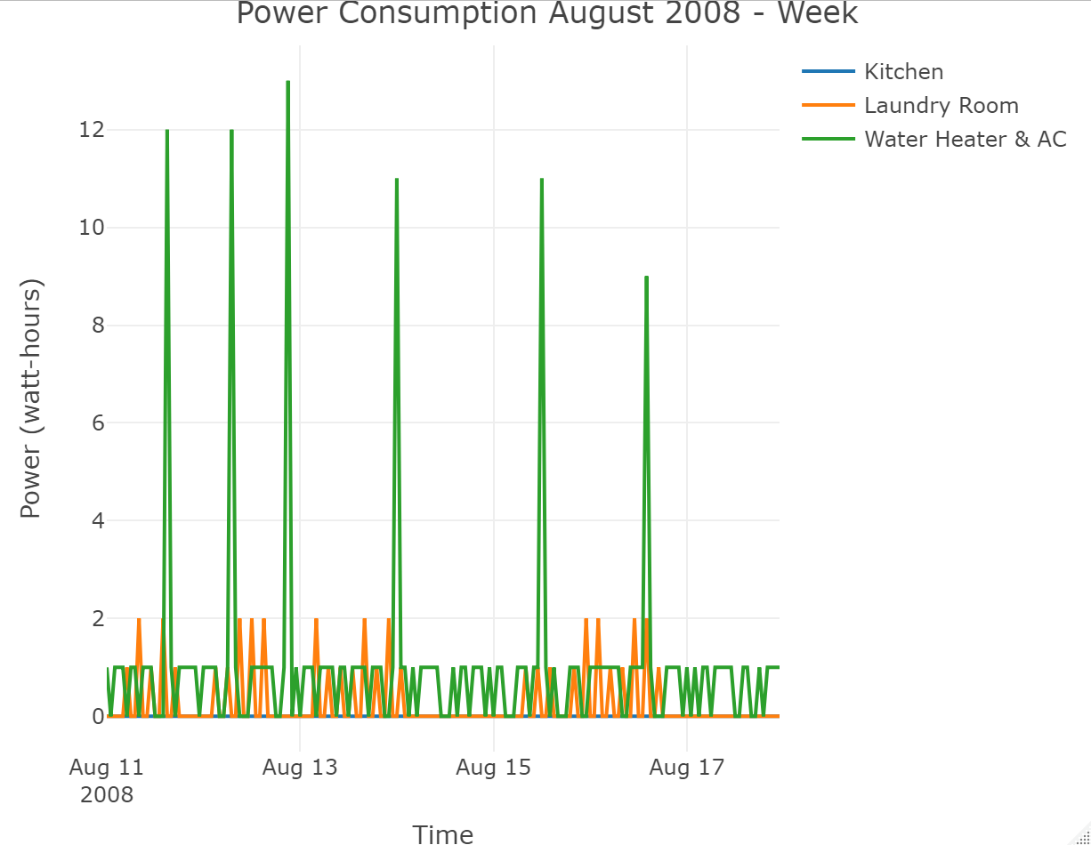
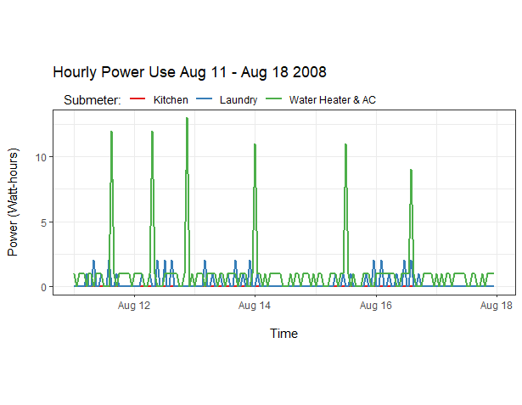
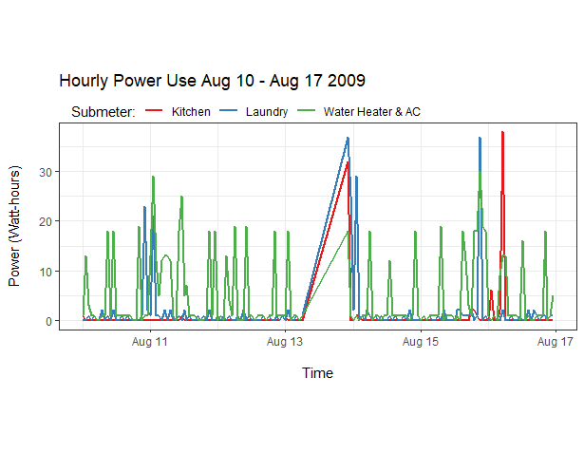
Time series analysis
All Submeters for the 33rd Week of Each Year

Slide 11
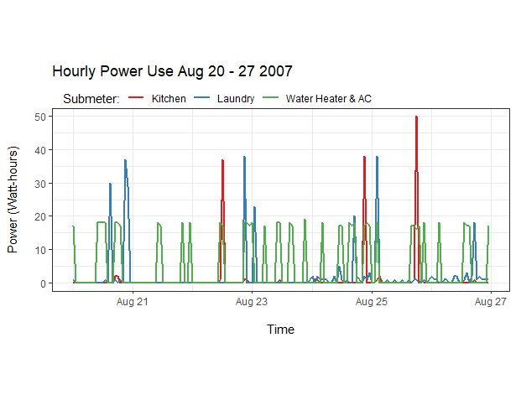
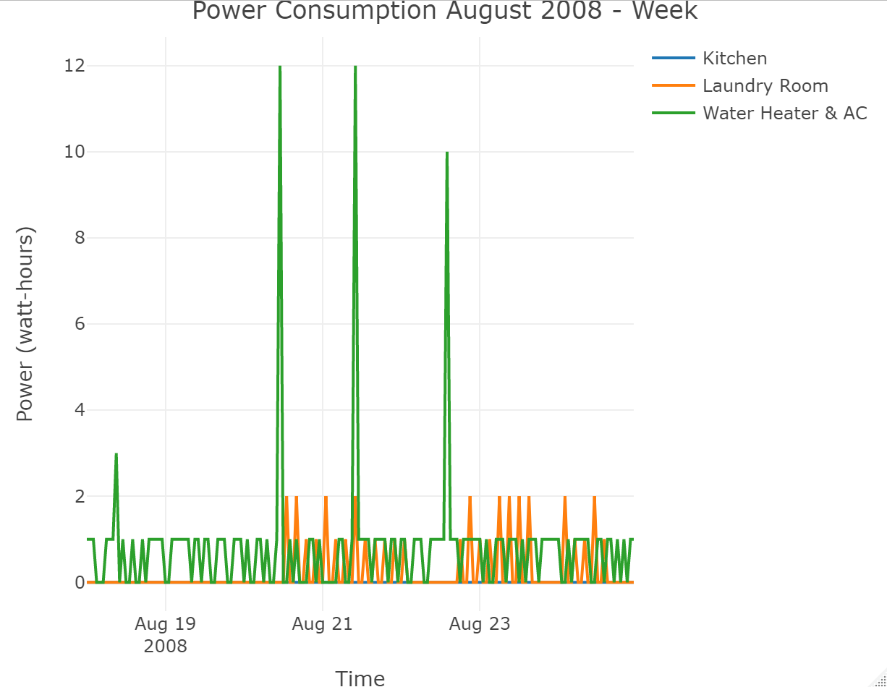
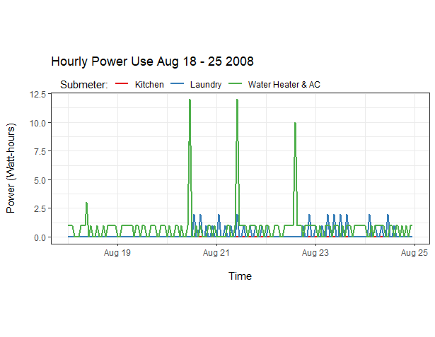
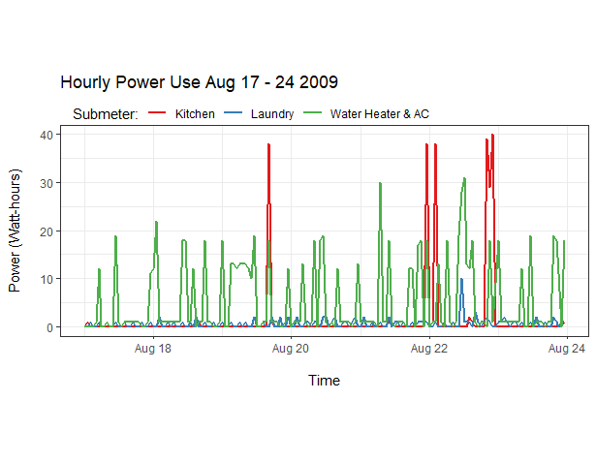
Time series analysis
All Submeters for the 34rd Week of Each Year

Slide 12

SUMMARY
As evidenced by the Time Series Analysis depicting energy consumption among the three submeters, the client did not occupy the residence during the month of August during the summer of 2008.

Slide 13

Time series regression models
We used linear regression models to forecast the time series of energy usage assuming there is an existent linear relationship with other time series

Slide 14
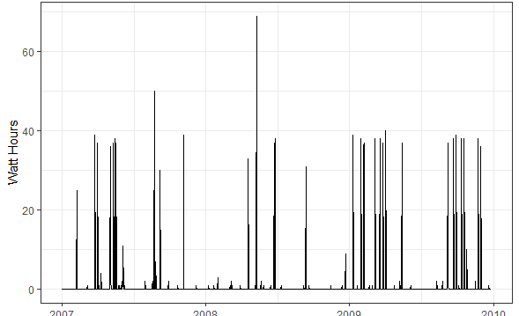
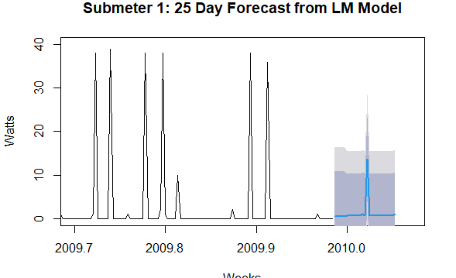
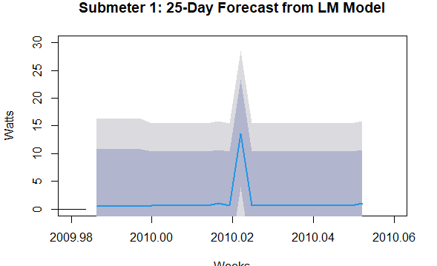
Linear regression models
Submeter 1 - Kitchen
We used linear regression models to forecast the time series of energy usage assuming there is an existent linear relationship with other time series
Forecast for energy use with sub_meter 1 Kitchen is on average quite low for 25 days, with one spike about midway.
The 75 and 90% confidence shadings showcase the variation in predictions. This variation is likely due to the long-time frame from which predictions were based (2007 to 2010), which included much seasonality.

Slide 15
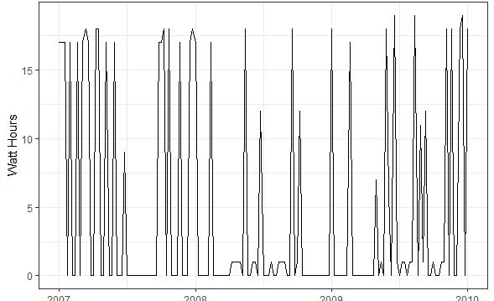
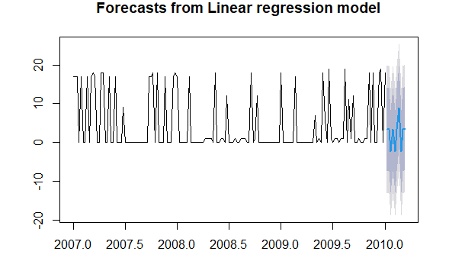
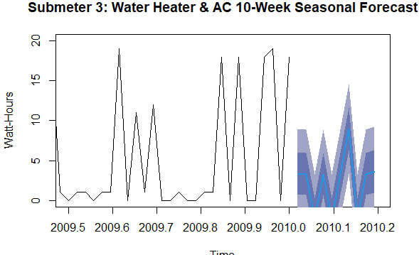
Linear regression models
Submeter 3 – Water Heater & A/C
Time series visualization of Sub_meter 3 using a weekly interval.
Forecast for energy use with sub_meter 3 shows a rather predictable pattern of higher energy usage between the first and last quarters of the years and a steady decline during the interim.
The 75 and 90% confidence shadings showcase the variation in predictions. Once again, upon closer examination we can see a great deal of seasonality playing into the forecast Sub3 over the following 2.5 months.

Slide 16
UNDERSTANDING tRENDS
In order to understand trends in the energy consumption data we have to separate out the underlying trend in energy use from what is purely random day-to-day fluctuation and/or seasonal fluctuation.
We do this with a method called ‘decomposition.’

Slide 17
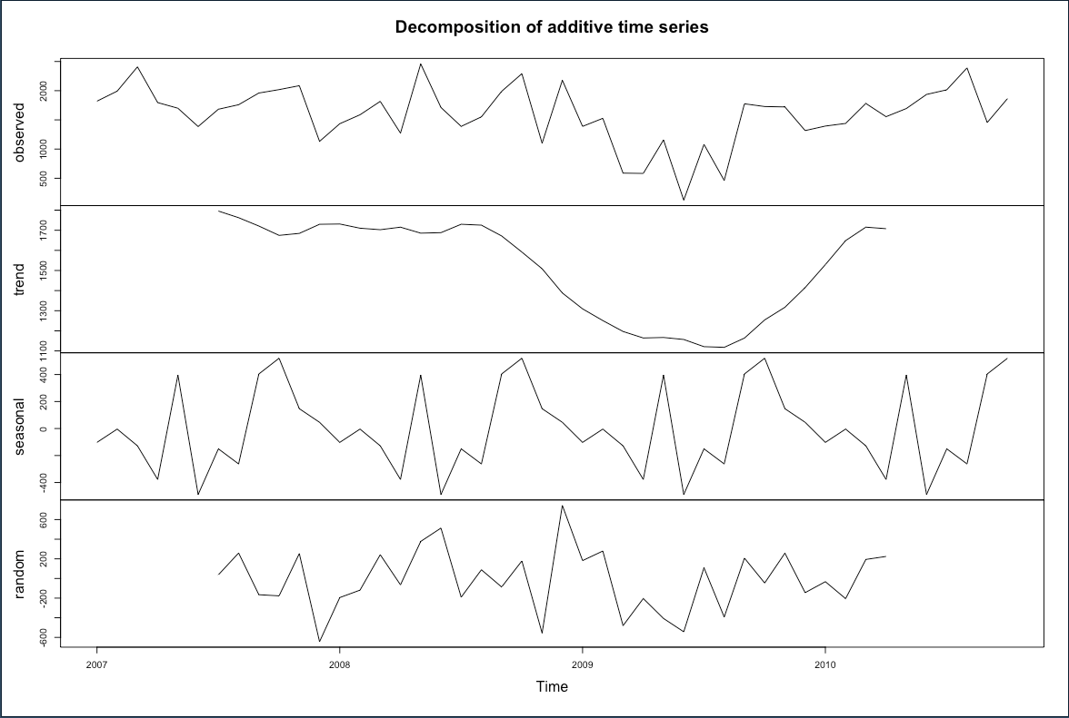
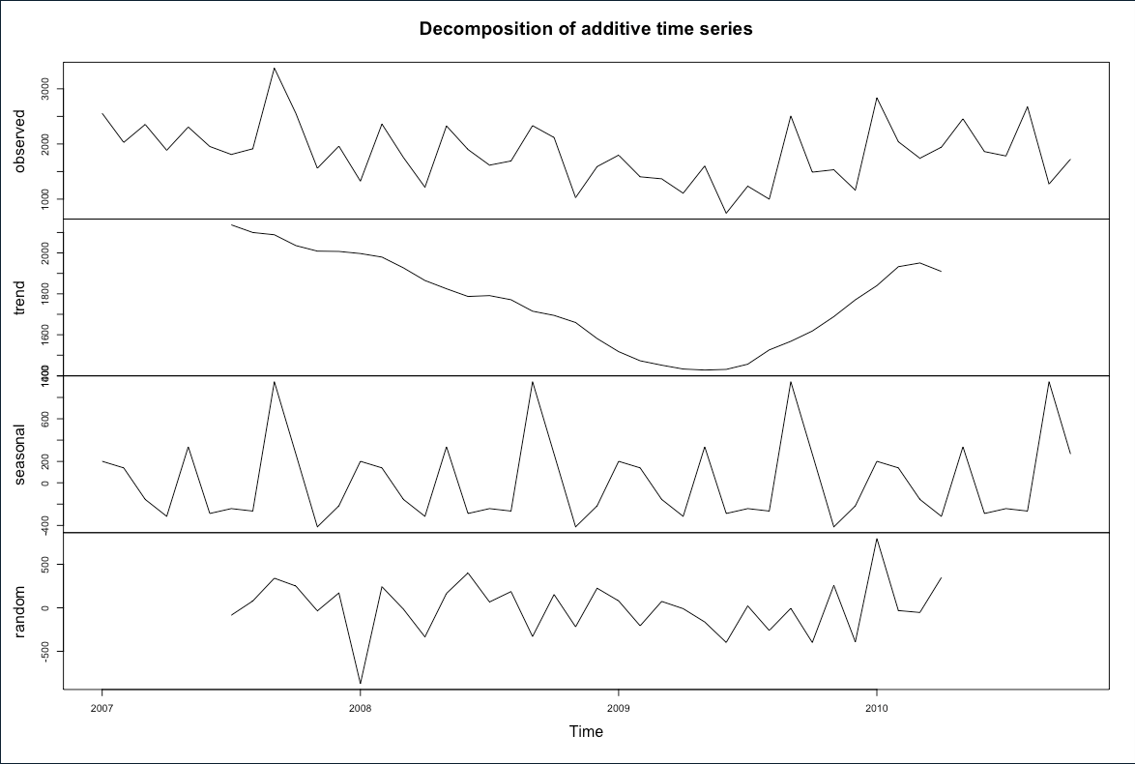
decomposition
Submeter – 1 : Kitchen
Submeter – 2 : Laundry

Slide 18
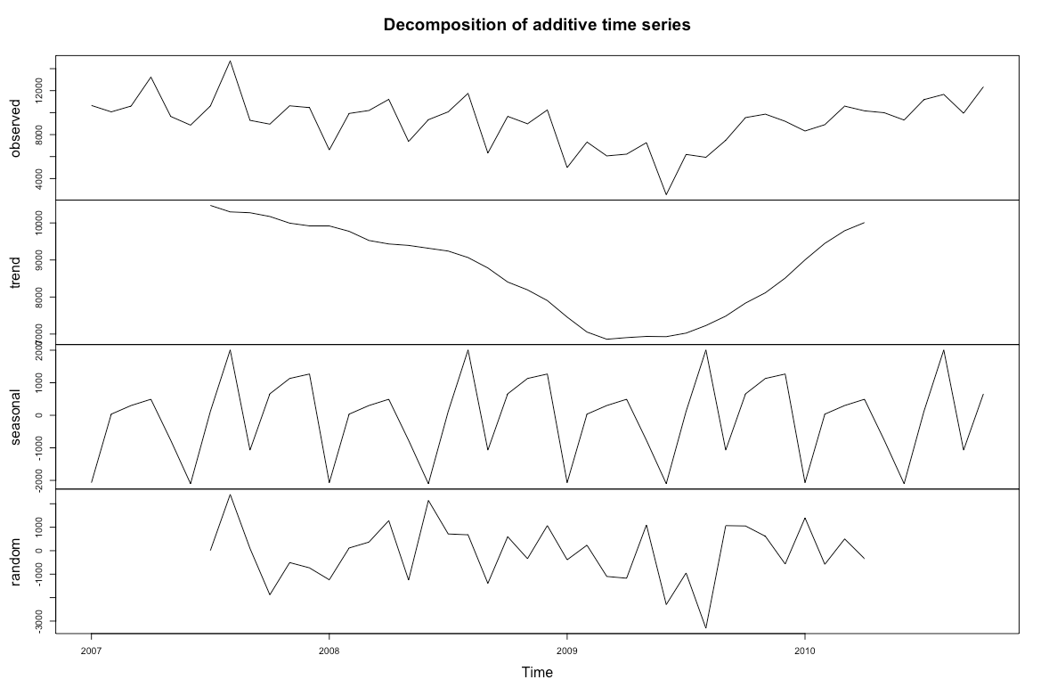
decomposition
Submeter – 3 : Water Heater & A/C
Conclusions
Seasonal trends are distinct for each sub-meter, reflecting the different use patterns for appliances on each.
All three sub-meters demonstrate the same long-term trend of decreased energy use in 2009, picking back up into 2010.

Slide 19

FORECASTs
We have chosen a method of forecasting known as ‘Holt-Winters’ forecasting’, this method allows us to separate out seasonal fluctuations, even when those seasonal fluctuations vary in magnitude over time, and make accurate projections of underlying trends into the future.

Slide 20
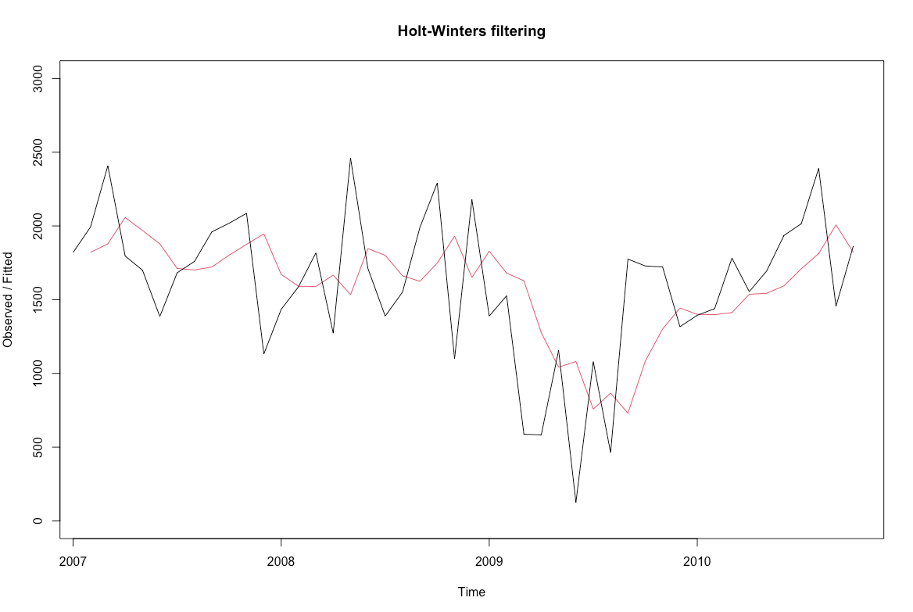
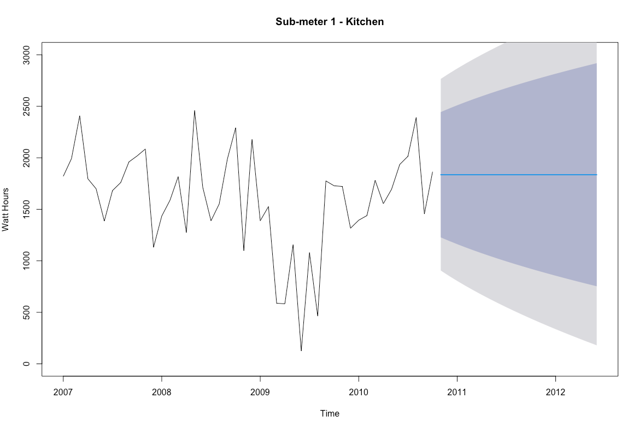
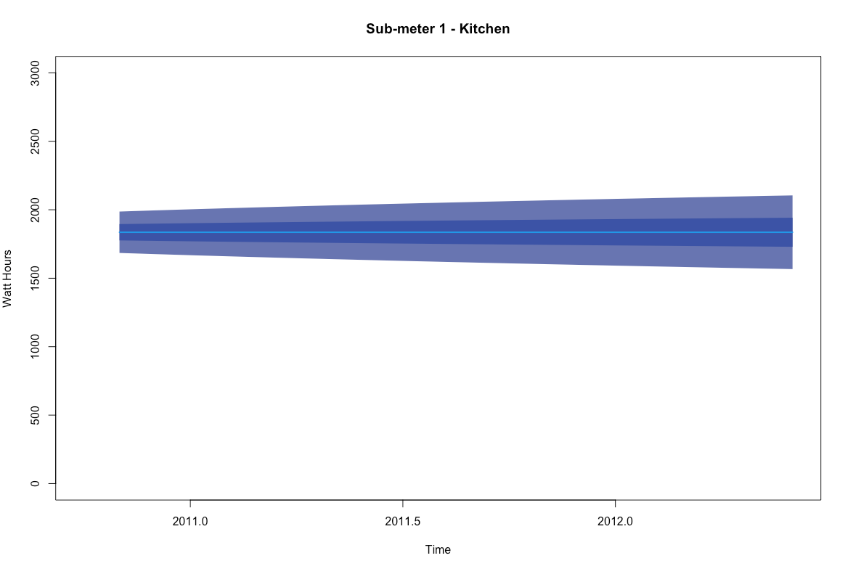
HOLT-WINTERS forecasting
SUBMETER – 1 : KITCHEN

Slide 21
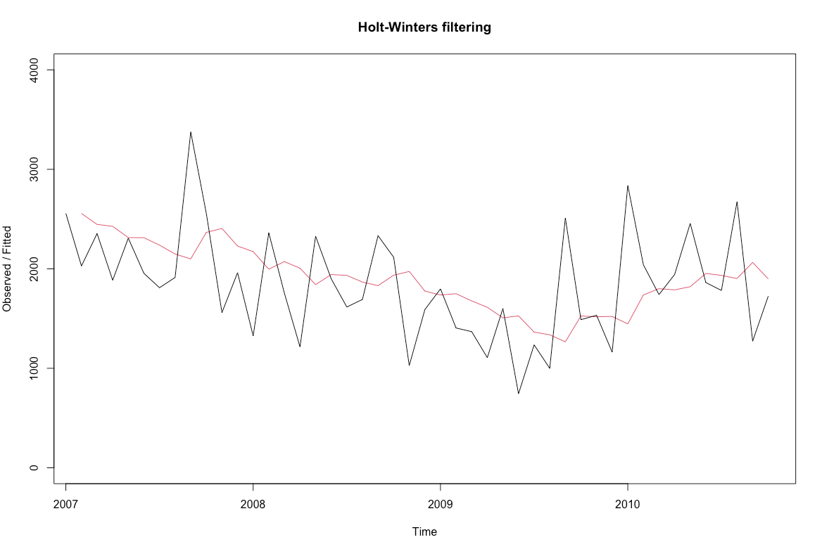
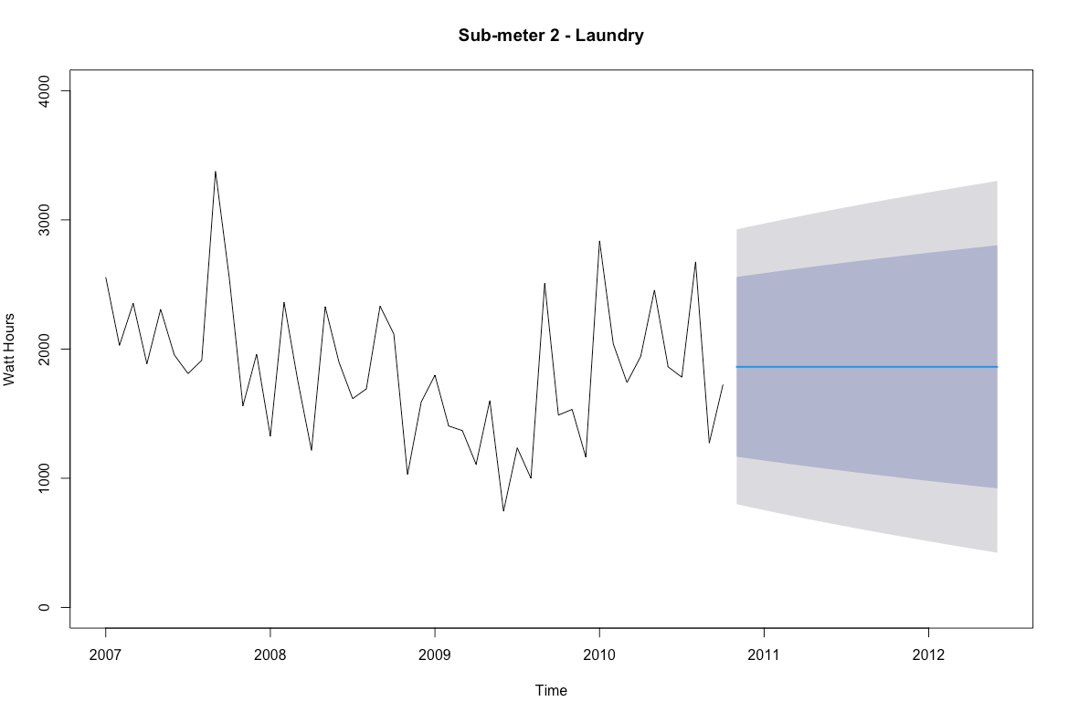
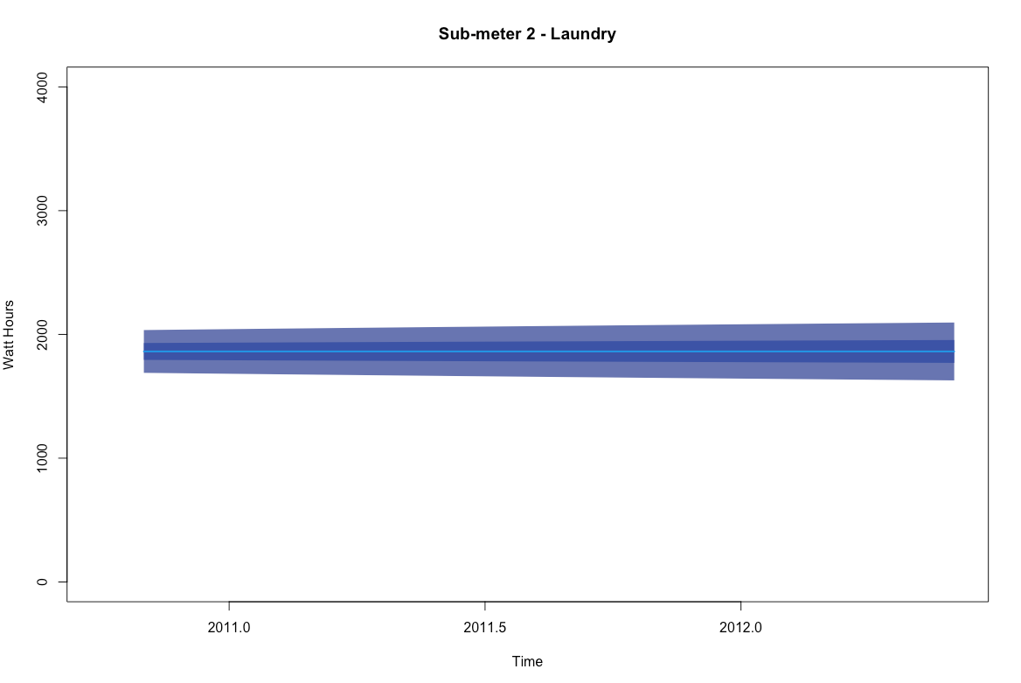
HOLT-WINTERS forecasting
SUBMETER – 2 : LAUNDRY

Slide 22
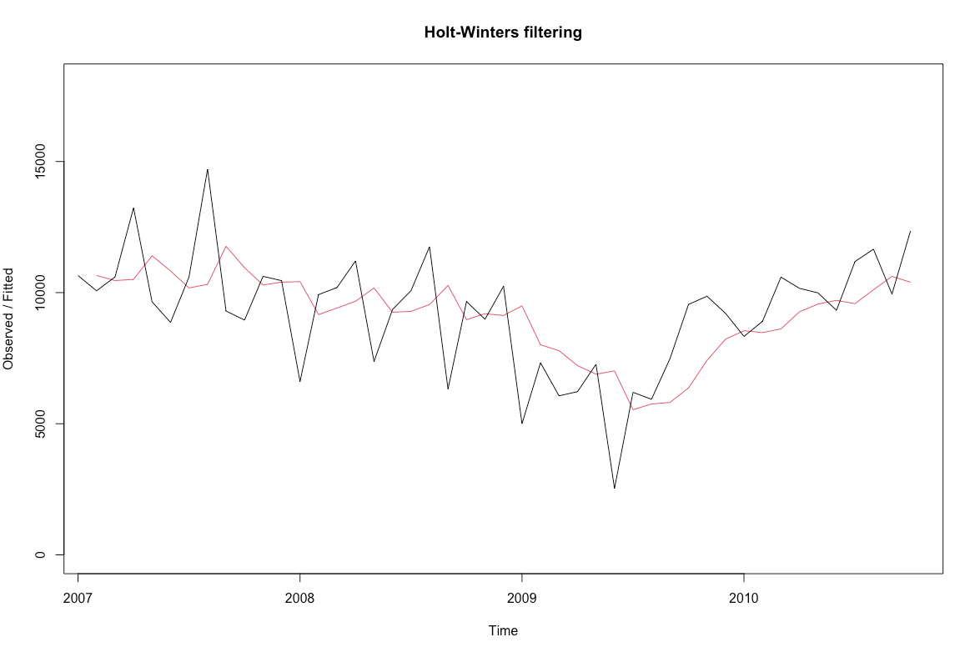
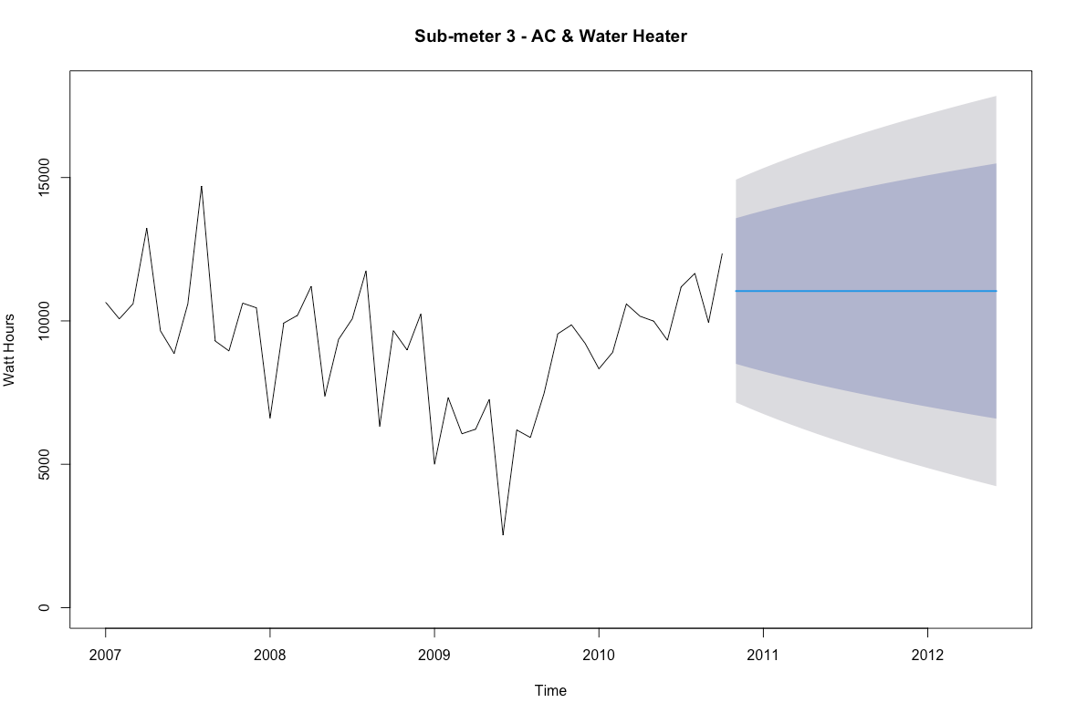
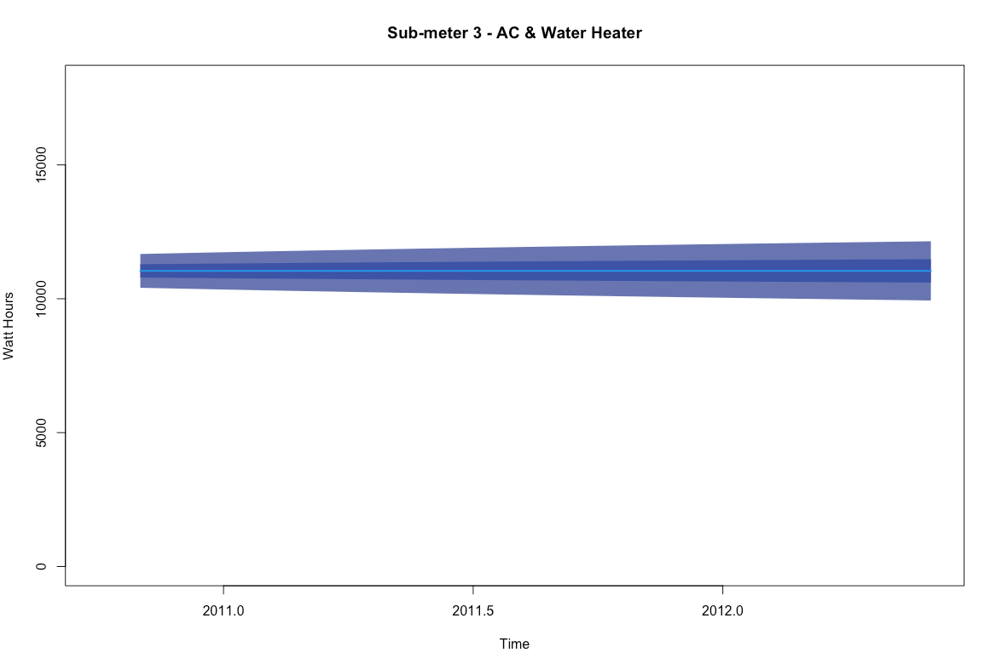
HOLT-WINTERS forecasting
SUBMETER – 3 : WATER HEATER & A/C

Slide 23
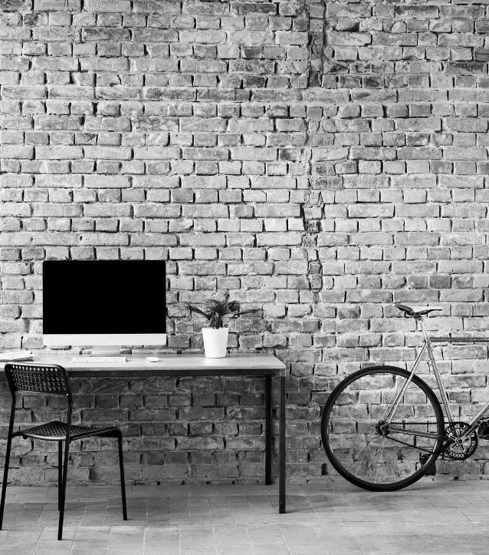
What’s next
LOOKING AHEAD

Slide 24

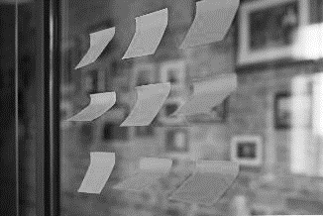

RECOMMENDATIONS
.
REALIGNMENT
A realignment of appliances among submeters to fix the location and purpose would make more sense. I.e. the refrigerator is currently being metered by Submeter 2, which registers the laundry room and its appropriate appliances, Submeter 1with the other appliances in the kitchen
BENCHMARKING
Consider consulting a third-party vendor to provide bill auditing and bench-marking services. For example, they might compare the home’s performance to similar properties in the vicinity to find ways to reduce the bill. Some skilled utility billing companies also offer these services. They can even go a step further, checking for consistent percentages, monitoring for leaks and comparing last year’s billing period to the current bill. All to verify the property is performing well over time.
WASTE REDUCTION
There is a pattern of heater or A/C use around early morning and evening.
There is a pattern of higher household electricity use during winter months.
Due to these patterns, it is recommended that insulation of the housing be increased to reduce thermal wasting.

Slide 25


THANK YOU
MICHAEL
KRISTI
JONATHAN
DEBASMITA
GROUP Z

